Slide 1
Comparison of neutral gas pressures
W7-X team
1

Slide 2
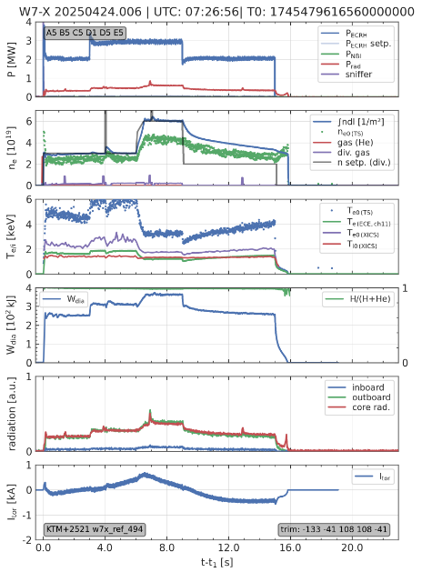
comparison OP2.1/2.2/2.3 data (time=5.5 s., 8 s.)
power ok:
EIM000+2520 https://w7x-logbook.ipp-hgw.mpg.de/log.html?id=XP_20240918.5
KJM001+2650 https://w7x-logbook.ipp-hgw.mpg.de/log.html?id=XP_20241001.11
EIM000+2520 https://w7x-logbook.ipp-hgw.mpg.de/log.html?id=XP_20241105.10
EHM001+2520 https://w7x-logbook.ipp-hgw.mpg.de/log.html?id=XP_20241106.6
KJM008+2520 https://w7x-logbook.ipp-hgw.mpg.de/log.html?id=XP_20241120.8
EIM000+2520 https://w7x-logbook.ipp-hgw.mpg.de/log.html?id=XP_20241203.7
EIM000+2520 https://w7x-logbook.ipp-hgw.mpg.de/log.html?id=XP_20241212.9
density ok:
EIM000+2520 https://w7x-logbook.ipp-hgw.mpg.de/log.html?id=XP_20241023.10
KJM008+2620 https://w7x-logbook.ipp-hgw.mpg.de/log.html?id=XP_20241112.11
FTM004+2585 https://w7x-logbook.ipp-hgw.mpg.de/log.html?id=XP_20241113.18
FMM002+2520 https://w7x-logbook.ipp-hgw.mpg.de/log.html?id=XP_20241204.9
FTM004+2520 https://w7x-logbook.ipp-hgw.mpg.de/log.html?id=XP_20250423.32
power and density almost ok:
EIM000-2520 https://w7x-logbook.ipp-hgw.mpg.de/log.html?id=XP_20250326.11 (almost ok)
KJM008+2520 https://w7x-logbook.ipp-hgw.mpg.de/log.html?id=XP_20250508.15 (ne (small overshoot at the start)
EIM000+2520 https://w7x-logbook.ipp-hgw.mpg.de/log.html?id=XP_20250515.8
power and density ok (17 discharges):
EIM000+2520 https://w7x-logbook.ipp-hgw.mpg.de/log.html?id=XP_20241008.40 (cryo on)
EIM000+2520 https://w7x-logbook.ipp-hgw.mpg.de/log.html?id=XP_20241127.10 (cryo off)
EIM000+2520 https://w7x-logbook.ipp-hgw.mpg.de/log.html?id=XP_20241210.7 (cryo off)
EIM000+2520 https://w7x-logbook.ipp-hgw.mpg.de/log.html?id=XP_20241212.9 (cryo off)
EIM000+2520 https://w7x-logbook.ipp-hgw.mpg.de/log.html?id=XP_20250513.6 (cryo on)
EIM000+2520 https://w7x-logbook.ipp-hgw.mpg.de/log.html?id=XP_20250514.10 (cryo on)
EJM006-2520 https://w7x-logbook.ipp-hgw.mpg.de/log.html?id=XP_20250325.65 (cryo off)
KJM008+2520 https://w7x-logbook.ipp-hgw.mpg.de/log.html?id=XP_20241009.9 (cryo on)
KJM008+2520 https://w7x-logbook.ipp-hgw.mpg.de/log.html?id=XP_20241016.14 (cryo off)
KJM008-2620 https://w7x-logbook.ipp-hgw.mpg.de/log.html?id=XP_20250311.62 (cryo off?)
KOF000+2520 https://w7x-logbook.ipp-hgw.mpg.de/log.html?id=XP_20250513.54 (cryo on)
KTM000+2520 https://w7x-logbook.ipp-hgw.mpg.de/log.html?id=XP_20250424.6 (cryo off?)
FMM002+2520 https://w7x-logbook.ipp-hgw.mpg.de/log.html?id=XP_20241205.9 (cryo off)
FTM004+2520 https://w7x-logbook.ipp-hgw.mpg.de/log.html?id=XP_20250506.9 (cryo on)
FTM004+2520 https://w7x-logbook.ipp-hgw.mpg.de/log.html?id=XP_20250521.9 (cryo on)
FTM004+2585 https://w7x-logbook.ipp-hgw.mpg.de/log.html?id=XP_20241114.10 (cryo on)
FTM000-2620 https://w7x-logbook.ipp-hgw.mpg.de/log.html?id=XP_20250312.71 (cryo off?)
He/H2 comparison
EIM000+2520 (hydrogen) https://w7x-logbook.ipp-hgw.mpg.de/log.html?id=XP_20241023.11
EIM000+2520 (helium) https://w7x-logbook.ipp-hgw.mpg.de/log.html?id=XP_20250403.61

Slide 3
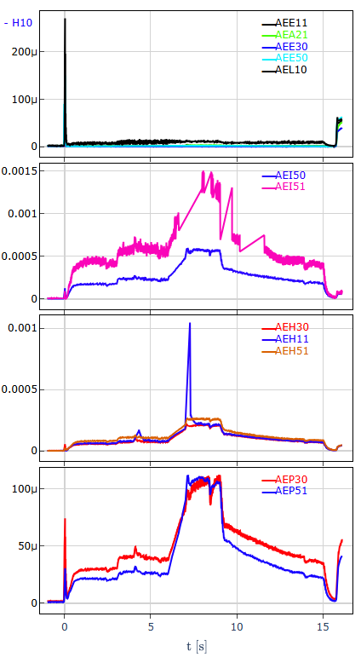
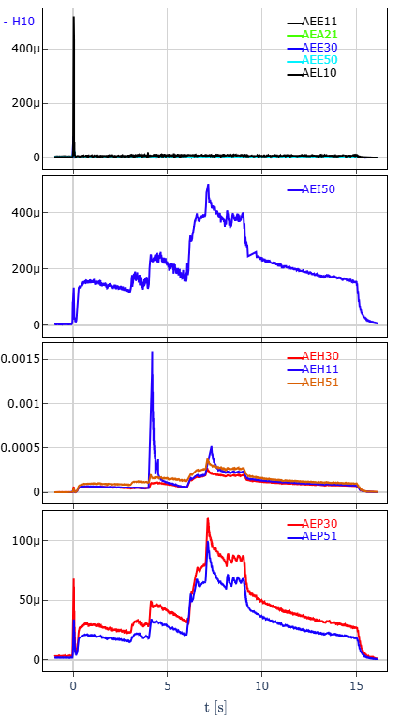
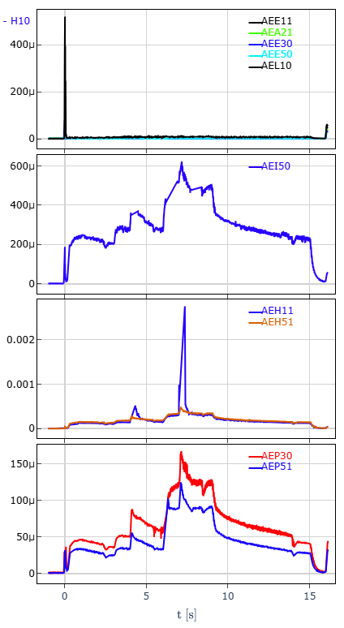
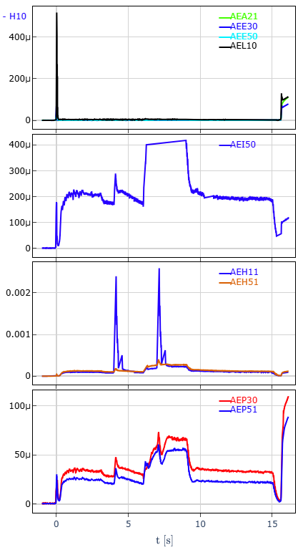
EIM OP2.2
power and density ok:
EIM000+2520 https://w7x-logbook.ipp-hgw.mpg.de/log.html?id=XP_20241008.40
EIM000+2520 https://w7x-logbook.ipp-hgw.mpg.de/log.html?id=XP_20241127.10
EIM000+2520 https://w7x-logbook.ipp-hgw.mpg.de/log.html?id=XP_20241210.7
EIM000+2520 https://w7x-logbook.ipp-hgw.mpg.de/log.html?id=XP_20241212.7
EIM000-2520 https://w7x-logbook.ipp-hgw.mpg.de/log.html?id=XP_20250326.11 (almost ok)
EIM000+2520 https://w7x-logbook.ipp-hgw.mpg.de/log.html?id=XP_20241008.40
EIM000+2520 https://w7x-logbook.ipp-hgw.mpg.de/log.html?id=XP_20241127.10
EIM000+2520 https://w7x-logbook.ipp-hgw.mpg.de/log.html?id=XP_20241210.7
EIM000+2520 https://w7x-logbook.ipp-hgw.mpg.de/log.html?id=XP_20241127.10
OP2.2

Slide 4
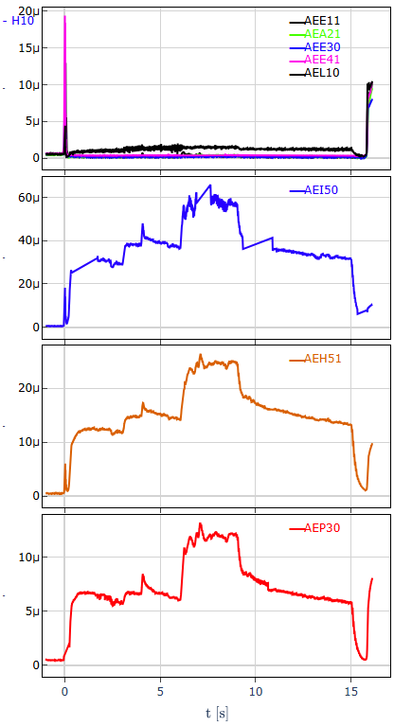
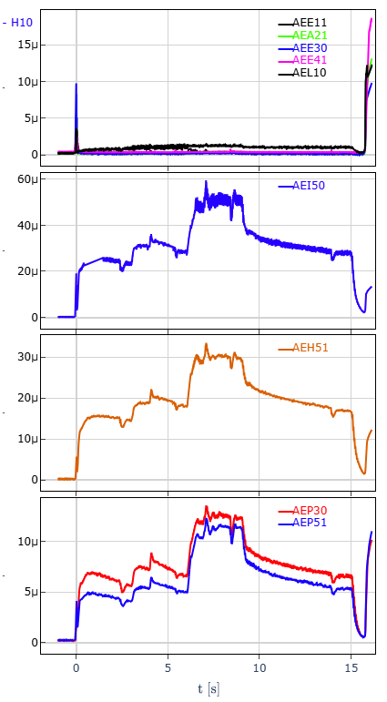
EIM OP2.2/OP2.3
power and density ok:
EIM000+2520 https://w7x-logbook.ipp-hgw.mpg.de/log.html?id=XP_20241008.40
EIM000+2520 https://w7x-logbook.ipp-hgw.mpg.de/log.html?id=XP_20241127.10
EIM000+2520 https://w7x-logbook.ipp-hgw.mpg.de/log.html?id=XP_20241210.7
EIM000+2520 https://w7x-logbook.ipp-hgw.mpg.de/log.html?id=XP_20241212.7
EIM000-2520 https://w7x-logbook.ipp-hgw.mpg.de/log.html?id=XP_20250326.11 (almost ok)
EIM000+2520 https://w7x-logbook.ipp-hgw.mpg.de/log.html?id=XP_20241127.10
EIM000-2520 https://w7x-logbook.ipp-hgw.mpg.de/log.html?id=XP_20250326.11
EIM000+2520 https://w7x-logbook.ipp-hgw.mpg.de/log.html?id=XP_20250410.5
OP2.2
OP2.3
reversed field
OP2.3
about one order of magnitude difference between OP2.2 and OP2.3 (calibration should be checked)

Slide 5
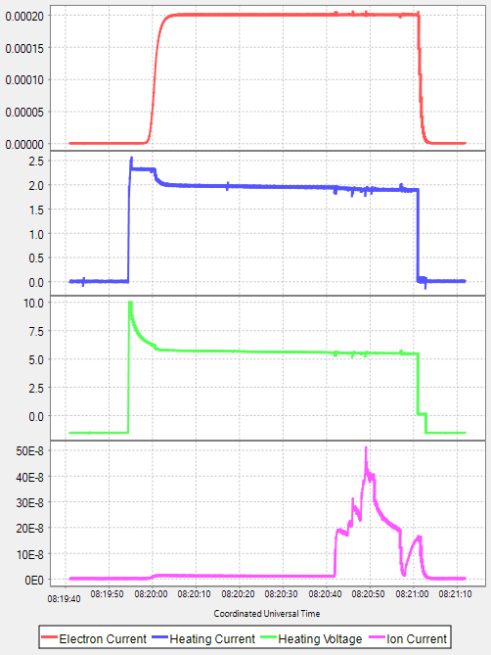
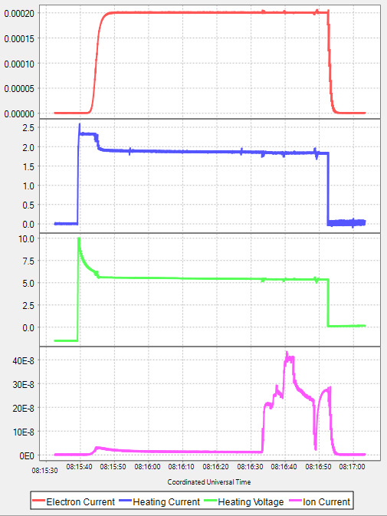
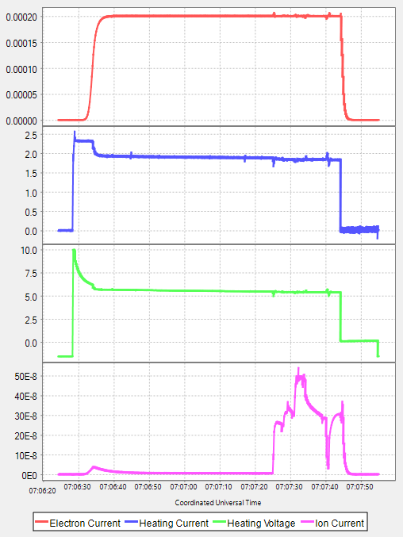
EIM OP2.2/OP2.3
power and density ok:
EIM000+2520 https://w7x-logbook.ipp-hgw.mpg.de/log.html?id=XP_20241008.40
EIM000+2520 https://w7x-logbook.ipp-hgw.mpg.de/log.html?id=XP_20241127.10
EIM000+2520 https://w7x-logbook.ipp-hgw.mpg.de/log.html?id=XP_20241210.7
EIM000+2520 https://w7x-logbook.ipp-hgw.mpg.de/log.html?id=XP_20241212.7
EIM000-2520 https://w7x-logbook.ipp-hgw.mpg.de/log.html?id=XP_20250326.11 (almost ok)
EIM000+2520 https://w7x-logbook.ipp-hgw.mpg.de/log.html?id=XP_20241127.10
EIM000-2520 https://w7x-logbook.ipp-hgw.mpg.de/log.html?id=XP_20250326.11
EIM000+2520 https://w7x-logbook.ipp-hgw.mpg.de/log.html?id=XP_20250410.5
OP2.2
OP2.3
reversed field
OP2.3
AEH51
AEH51
AEH51

Slide 6
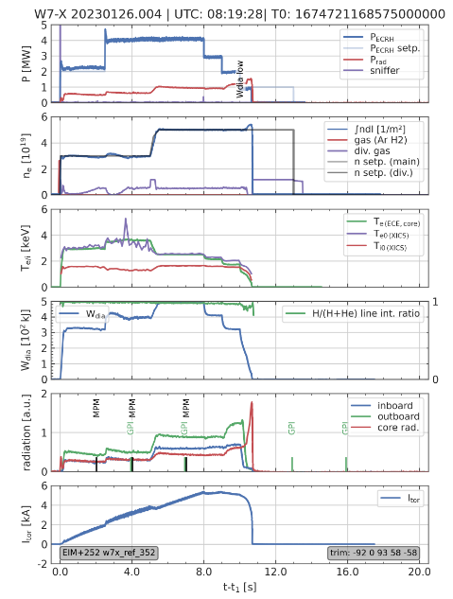
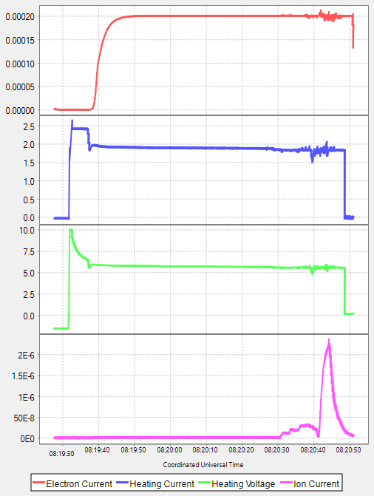
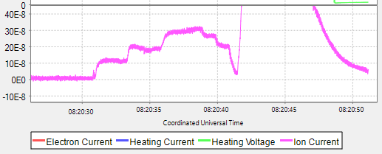
EIM OP2.1
EIM005+2520 https://w7x-logbook.ipp-hgw.mpg.de/log.html?id=XP_20230126.4
OP2.1
AEH30

Slide 7
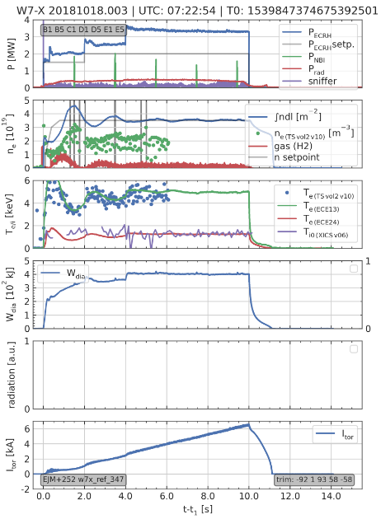
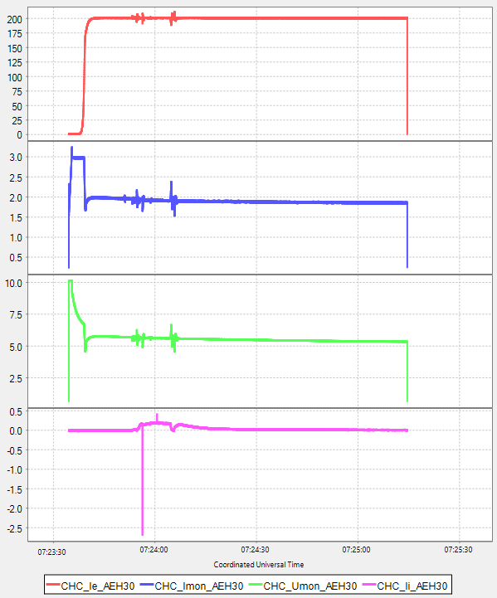
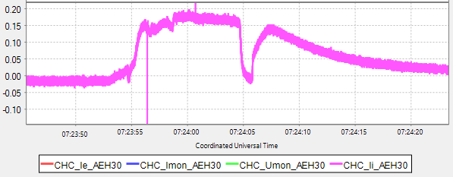
EIM OP1.2b
EIM+252 https://w7x-logbook.ipp-hgw.mpg.de/log.html?id=XP_20181018.3
OP1.2b

Slide 8
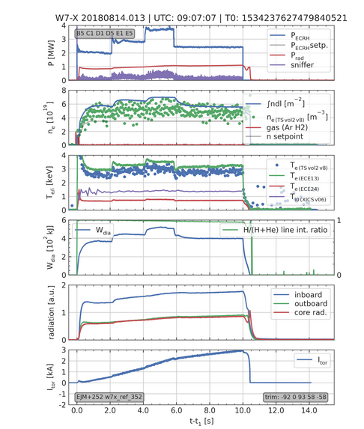
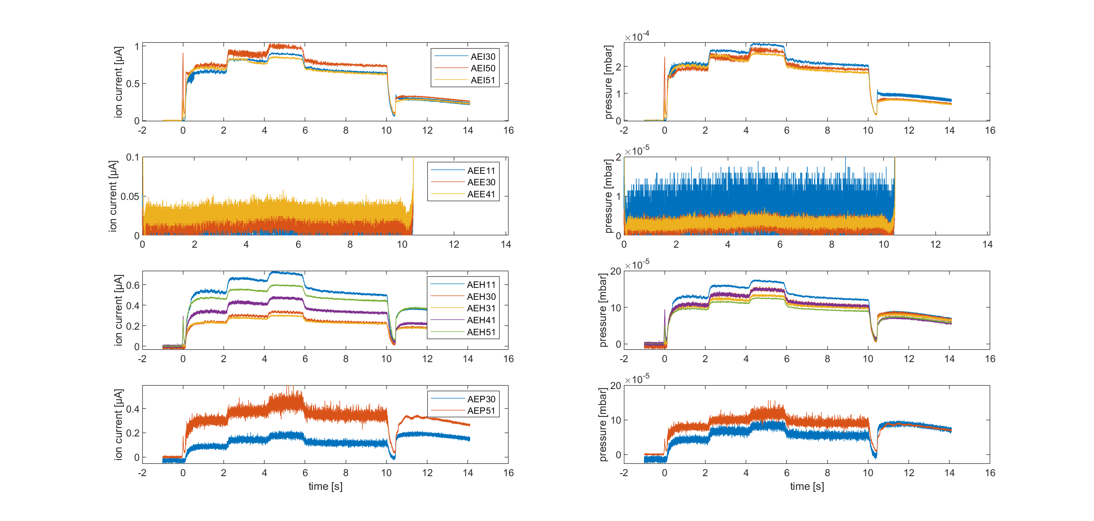
EJM OP1.2b
https://w7x-logbook.ipp-hgw.mpg.de/log.html?id=XP_20180814.13
OP1.2b
Source: V. Haak

Slide 9
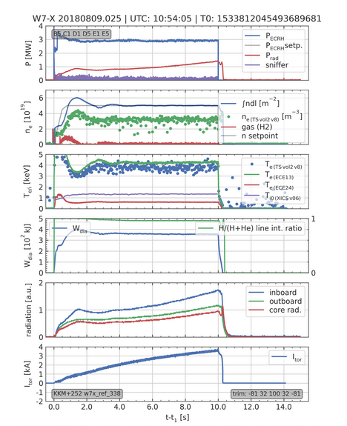
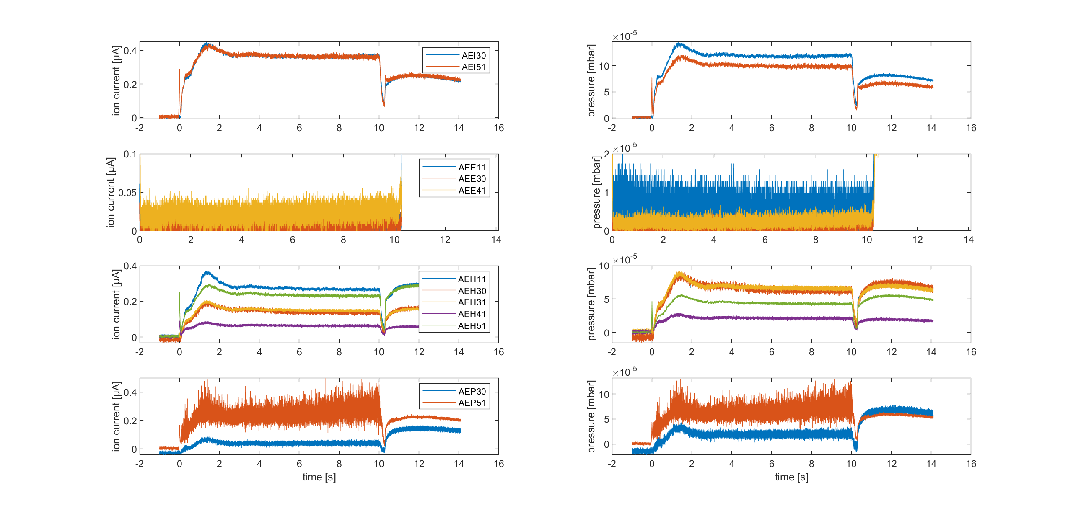
KKM OP1.2b
https://w7x-logbook.ipp-hgw.mpg.de/log.html?id=XP_20180809.25
OP1.2b
Source: V. Haak

Slide 10
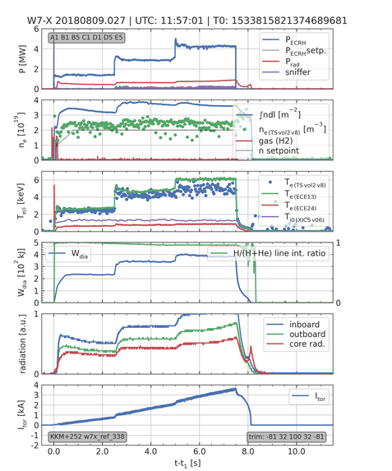
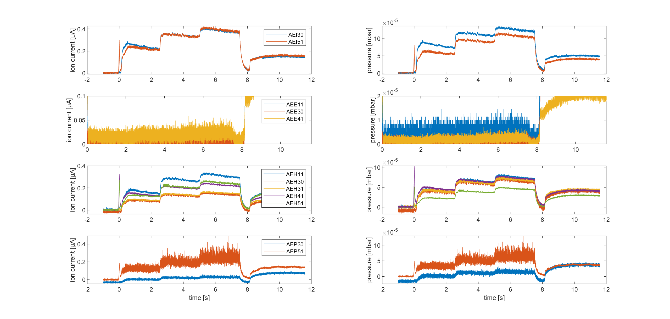
KKM OP1.2b
https://w7x-logbook.ipp-hgw.mpg.de/log.html?id=XP_20180809.27
OP1.2b
Source: V. Haak

Slide 11
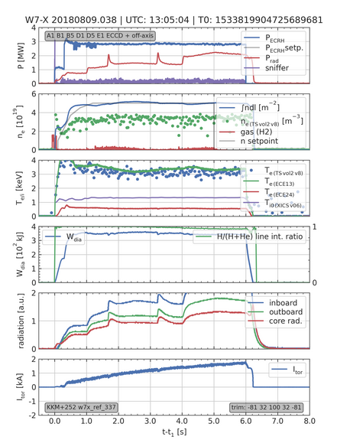
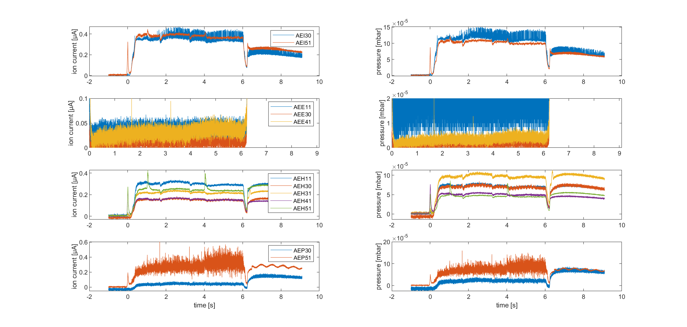
KKM OP1.2b
https://w7x-logbook.ipp-hgw.mpg.de/log.html?id=XP_20180809.38
OP1.2b
Source: V. Haak

Slide 12
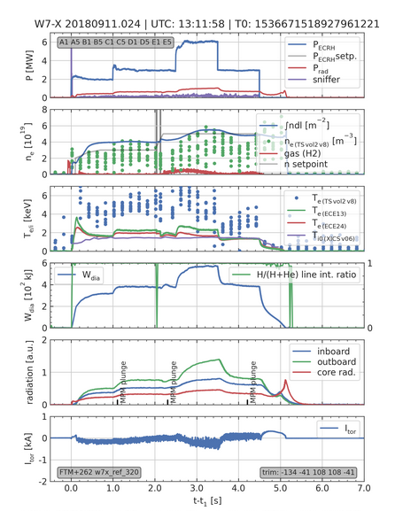
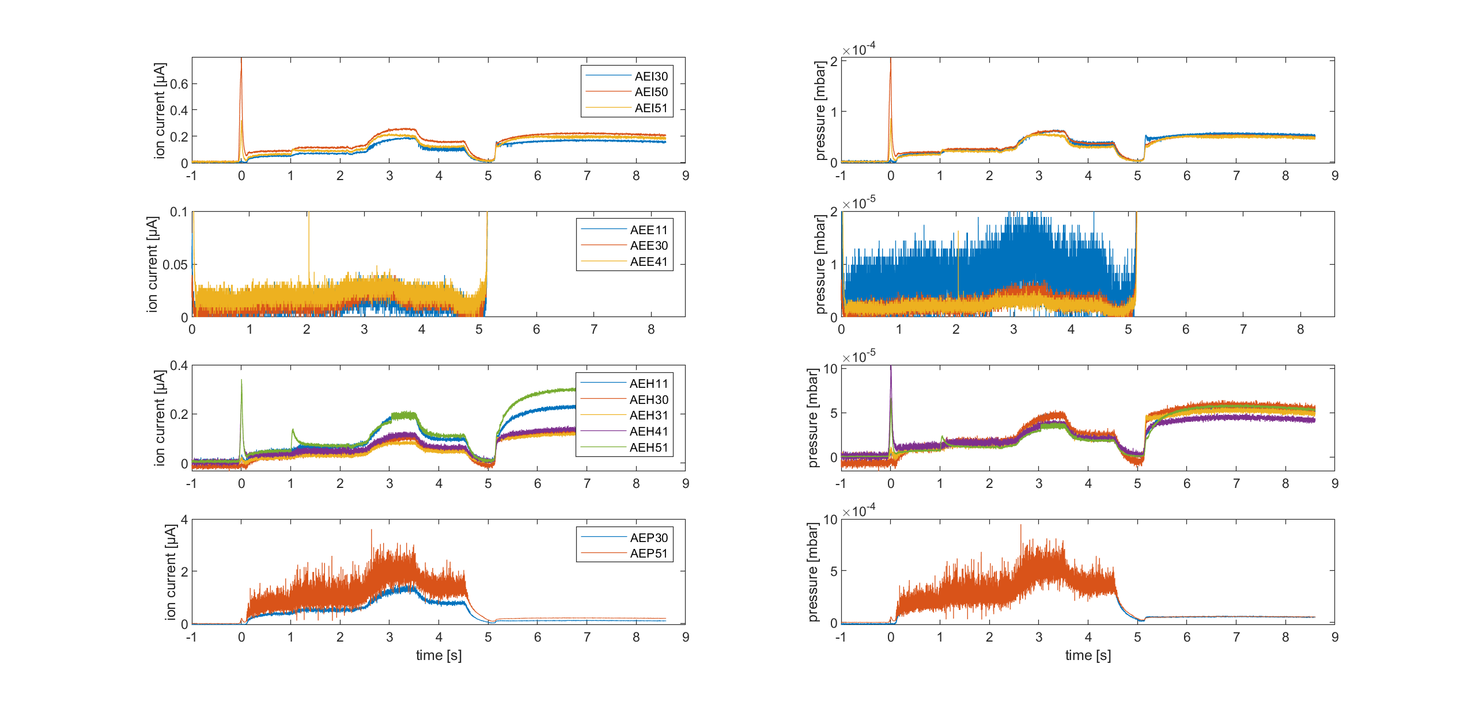
KKM OP1.2b
https://w7x-logbook.ipp-hgw.mpg.de/log.html?id=XP_20180911.24
OP1.2b
Source: V. Haak

Slide 13
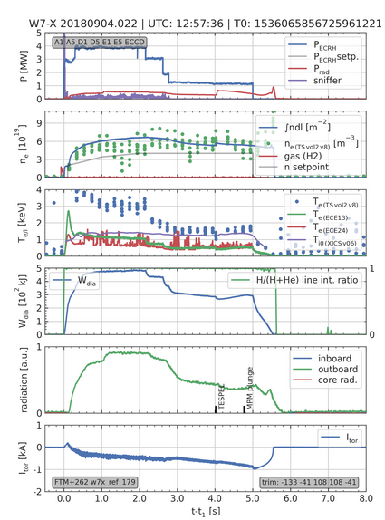
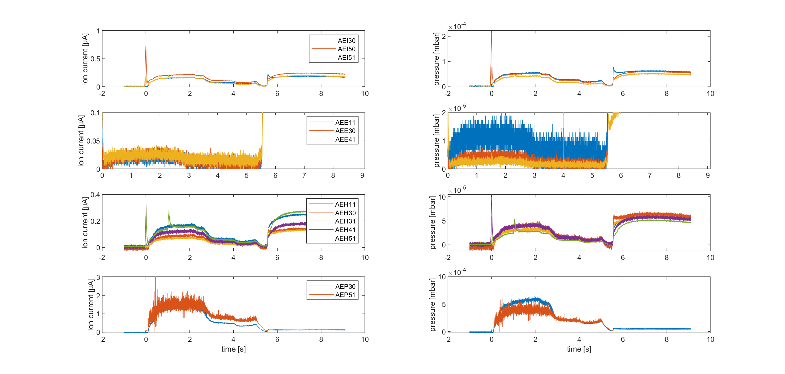
FTM OP1.2b
https://w7x-logbook.ipp-hgw.mpg.de/log.html?id=XP_20180904.22
OP1.2b
Source: V. Haak

Slide 14
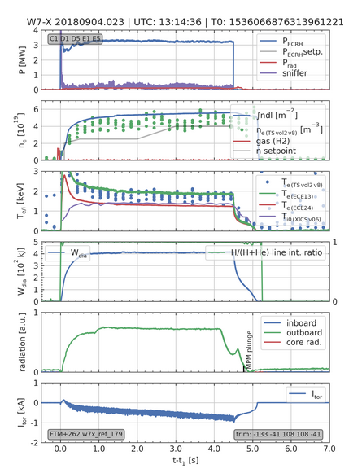
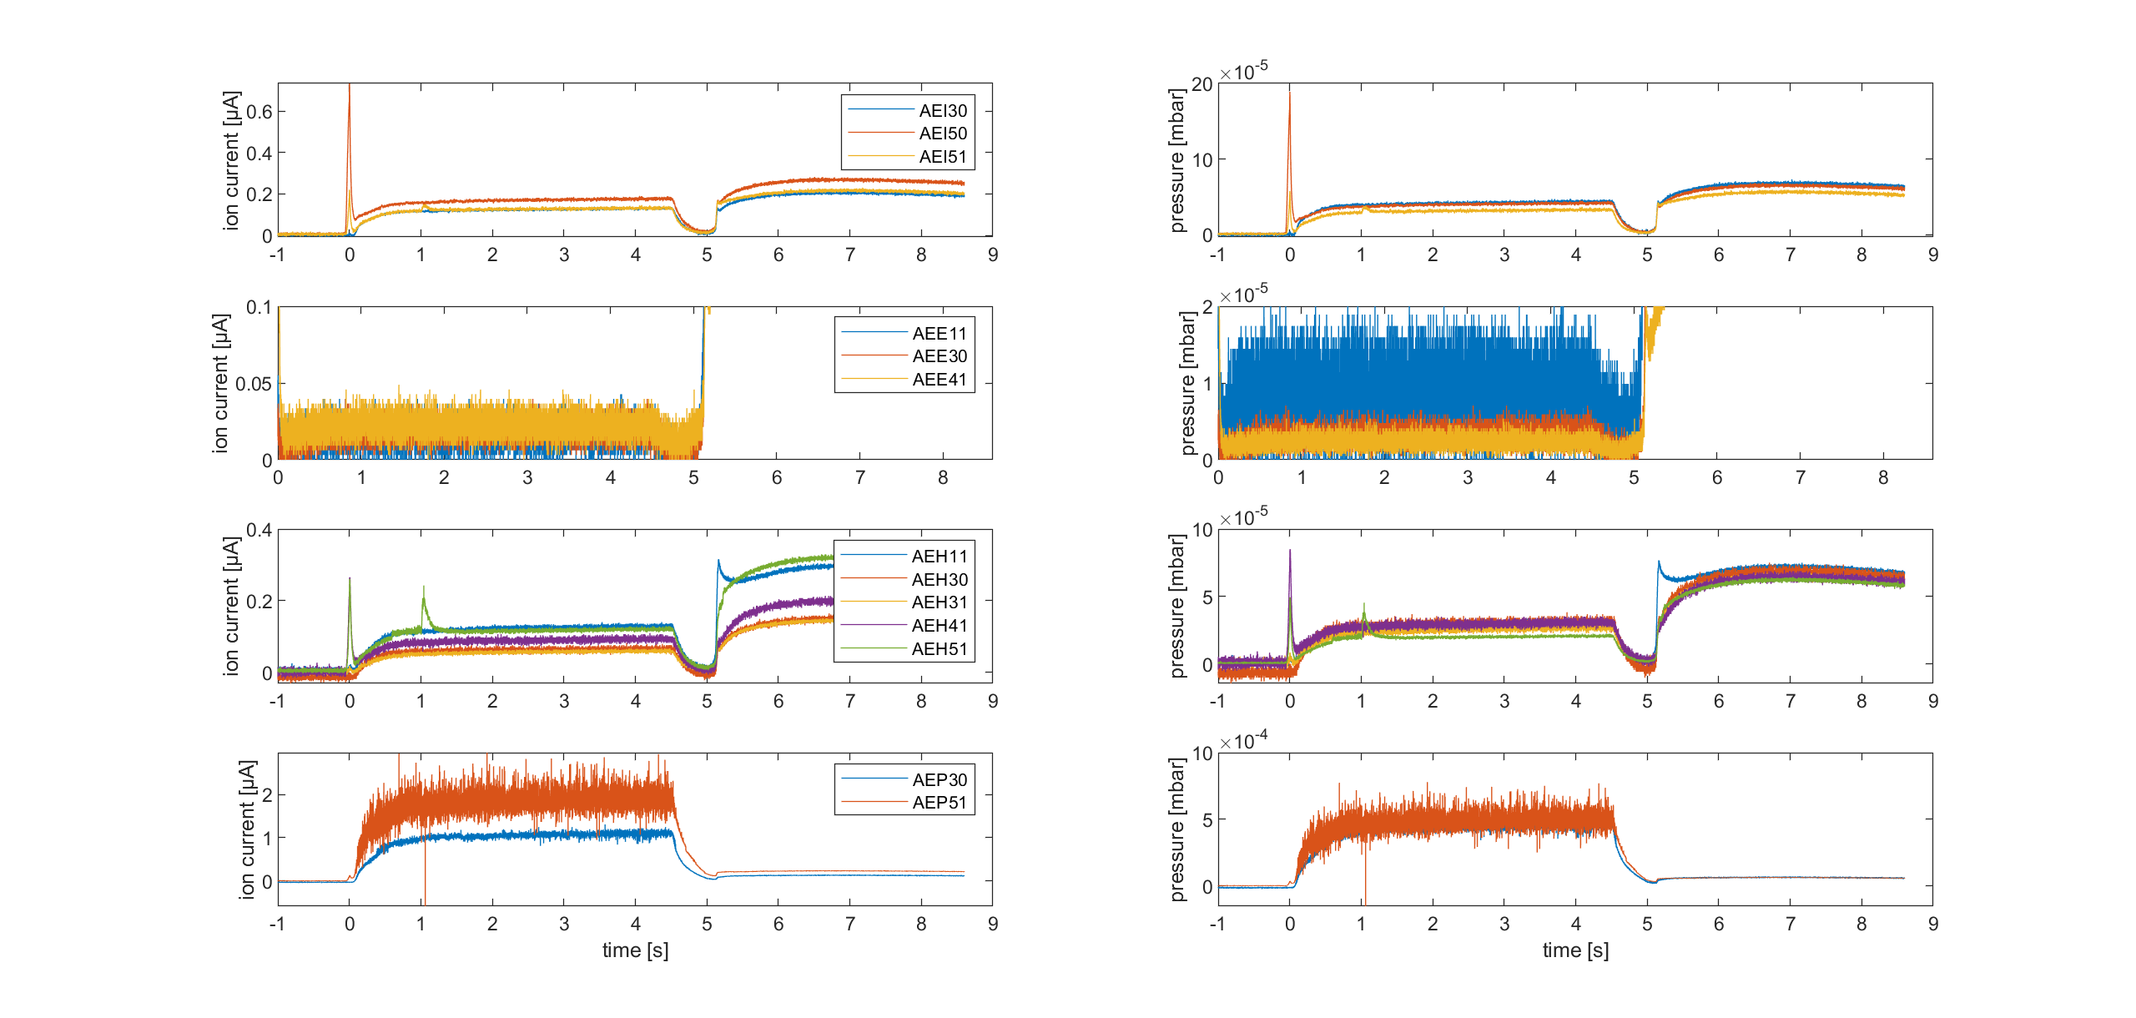
FTM OP1.2b
https://w7x-logbook.ipp-hgw.mpg.de/log.html?id=XP_20180904.23
OP1.2b
Source: V. Haak

Slide 15
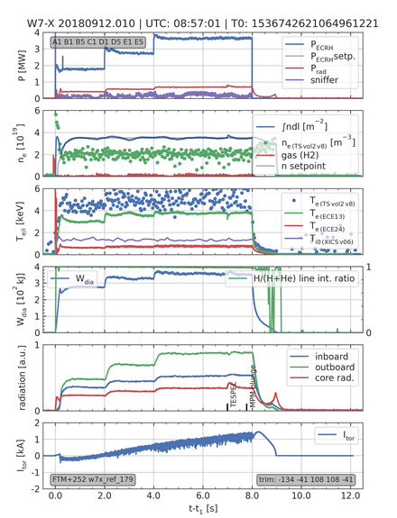
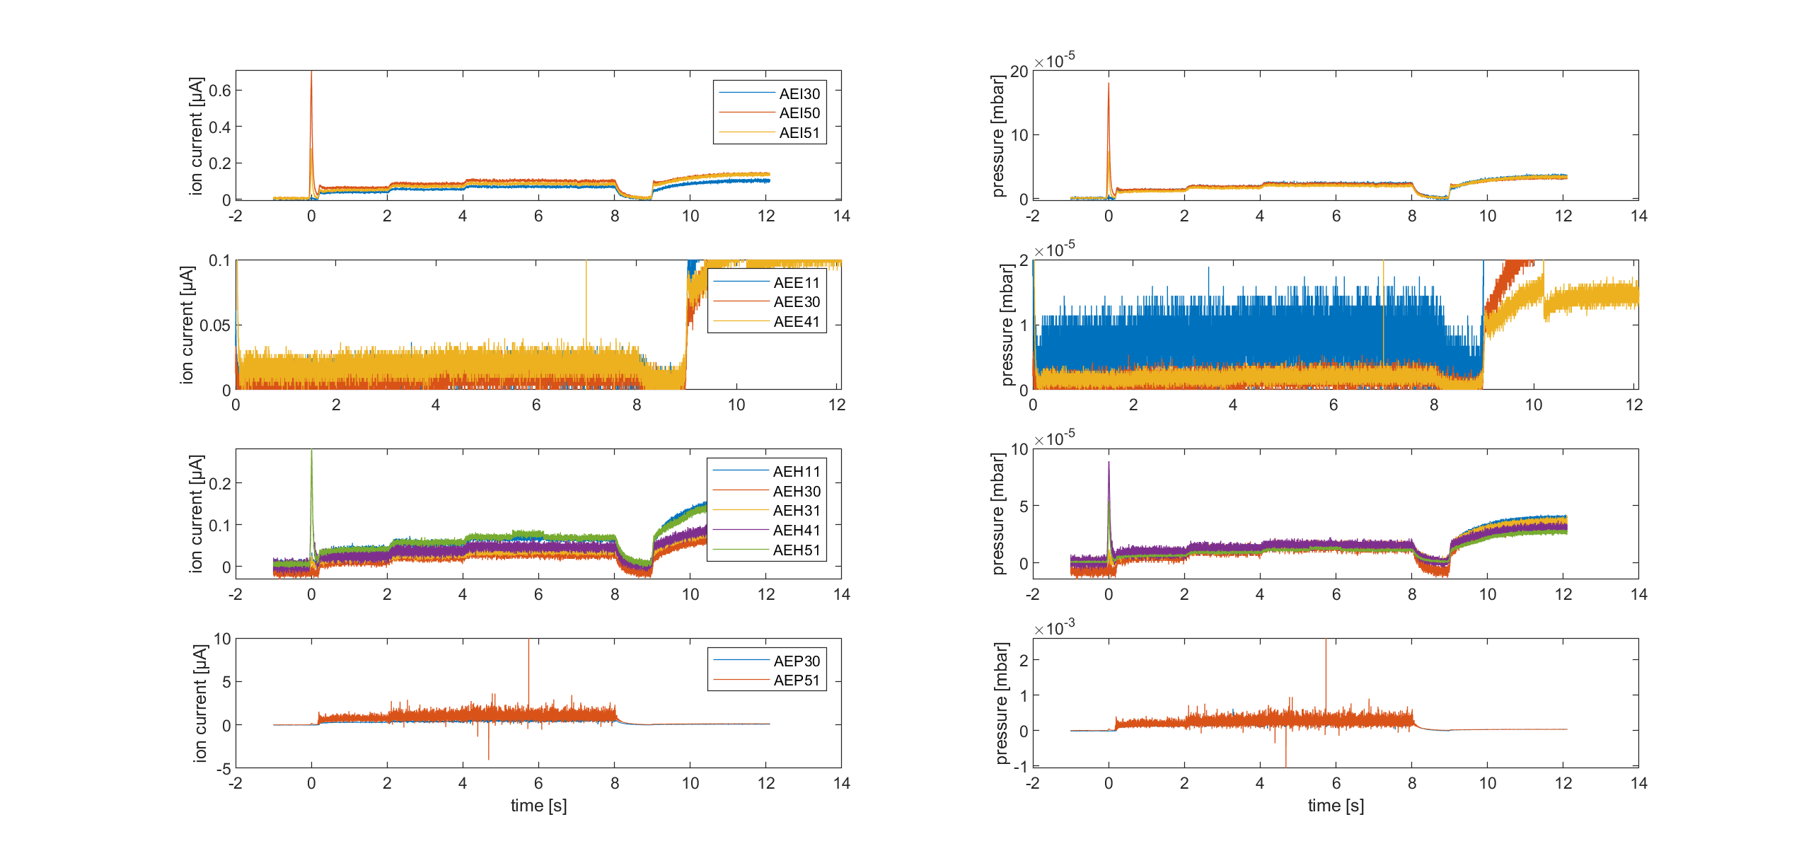
FTM OP1.2b
https://w7x-logbook.ipp-hgw.mpg.de/log.html?id=XP_20180912.10
OP1.2b
Source: V. Haak

Slide 16
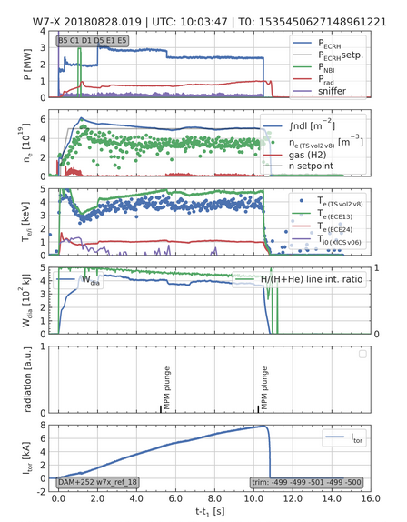
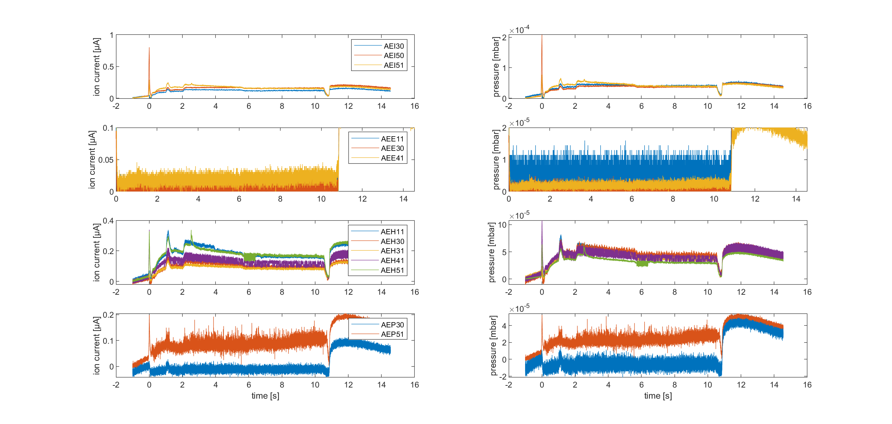
DAM OP1.2b
https://w7x-logbook.ipp-hgw.mpg.de/log.html?id=XP_20180828.19
OP1.2b
Source: V. Haak

Slide 17
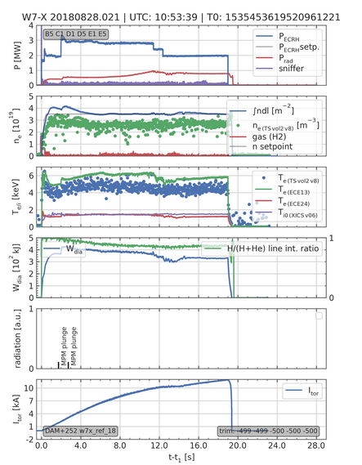
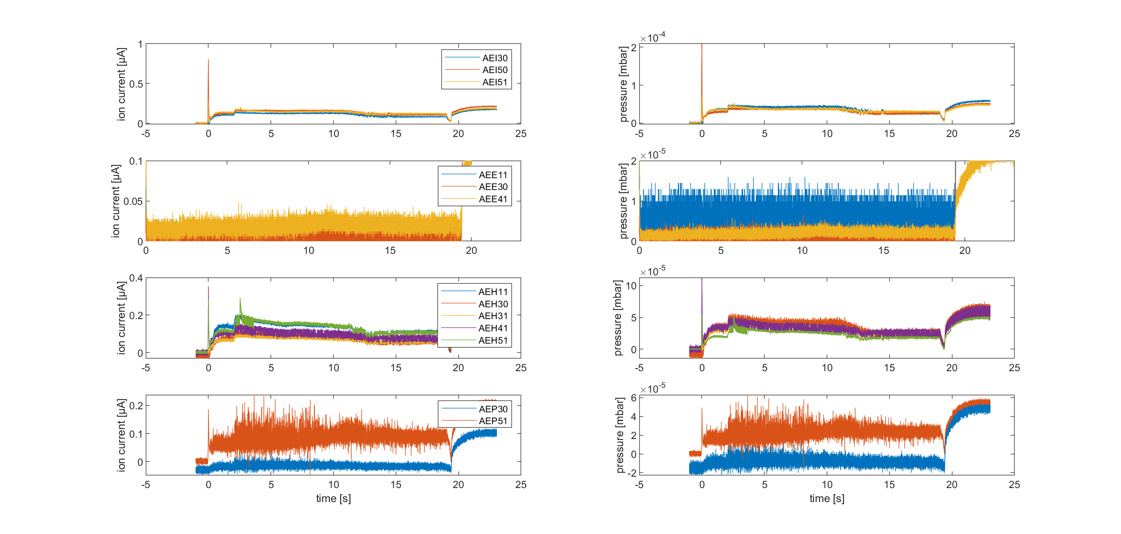
DAM OP1.2b
https://w7x-logbook.ipp-hgw.mpg.de/log.html?id=XP_20180828.21
OP1.2b
Source: V. Haak

Slide 18
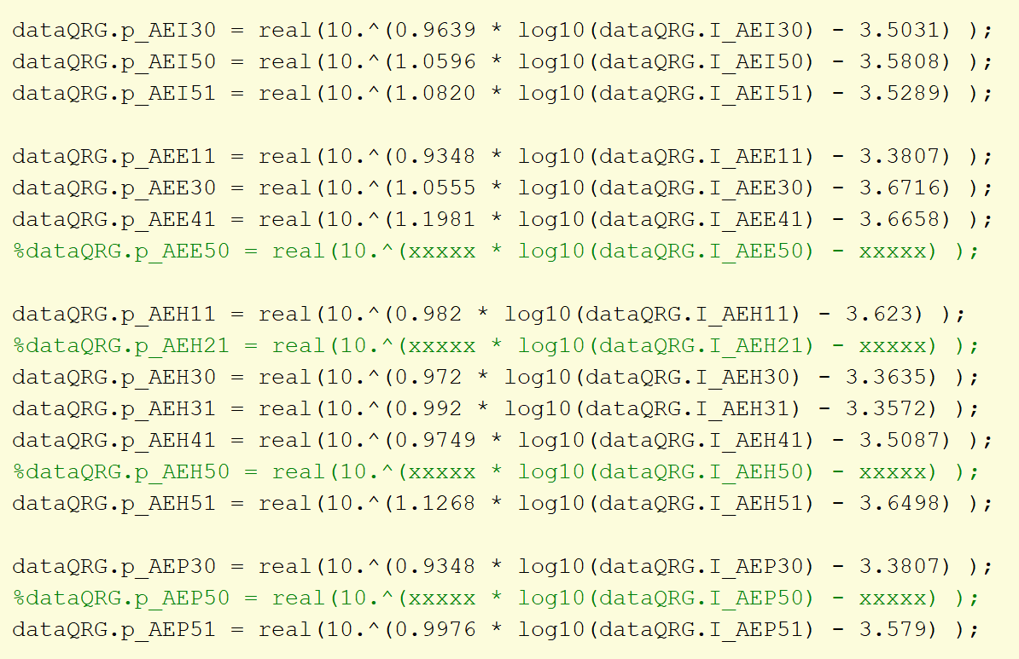
Calibration OP1.2b
Source: V. Haak

Slide 19
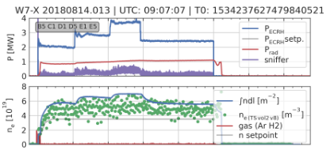
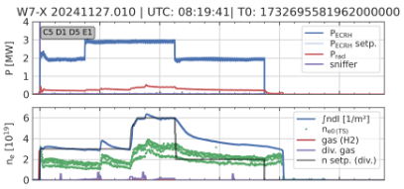
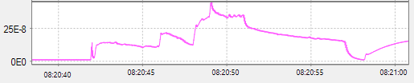
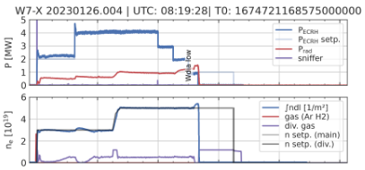
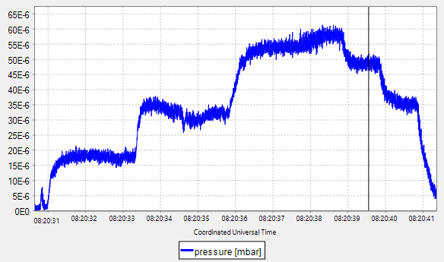
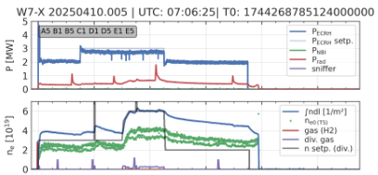
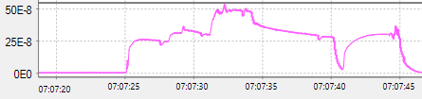
Comparison AEH30 OP1.2b - OP2.3 in stand. config.
OP1.2b
ECRH 3 MW, n_{e,dl} = 5-7e19 m⁻²
OP2.2
I_{AEH30} = 0.34 μA, p = 2x10⁻⁴ mbar
I_{AEH51} = 0.40 μA, p = 2.6x10⁻⁴ mbar
I_{AEH30} = 0.28 μA, p = 1 x10⁻⁴ mbar
I_{heat} = 1.88 A, I_{ele} = 0.0002 A
OP1.2b: EJM+252 https://w7x-logbook.ipp-hgw.mpg.de/log.html?id=XP_20180814.13
OP2.1: EIM005+2520 https://w7x-logbook.ipp-hgw.mpg.de/log.html?id=XP_20230126.4
I_{heat, AEH30} = 1.53 A, I_{ele} = 0.0002 A
I_{heat, AEH51} = 1.87 A, I_{ele} = 0.0002 A
OP2.2: EIM000+2520 https://w7x-logbook.ipp-hgw.mpg.de/log.html?id=XP_20241127.10
OP2.3: EIM000+2520 https://w7x-logbook.ipp-hgw.mpg.de/log.html?id=XP_20250410.5
OP2.3: EIM000+2520 https://w7x-logbook.ipp-hgw.mpg.de/log.html?id=XP_20250409.8
OP2.1
OP2.3
I_{AEH51} = 0.5 μA, p = 0.3x10⁻⁴ mbar
I_{AEH30} = 0.27 μA, p = 0.5x10⁻⁴ mbar
I_{heat} = 1.9 A, I_{ele} = 0.0002 A
I_{heat} = 1.8 A, I_{ele} = 0.0002 A

Slide 20
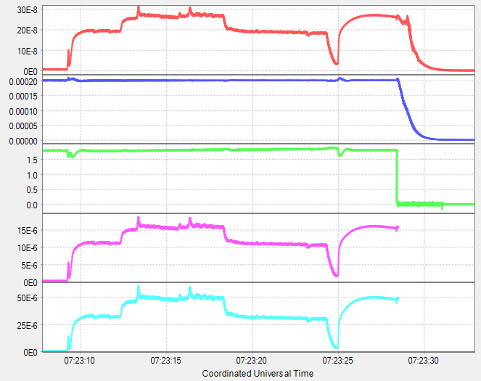
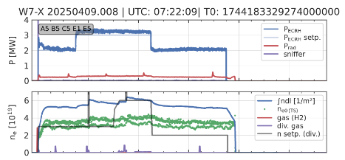
Comparison AEH30 OP1.2b - OP2.3 in stand. config.
OP1.2b
ECRH 3 MW, n_{e,dl} = 5-7e19 m⁻²
OP2.2
I_{AEH30} = 0.34 μA, p = 2x10⁻⁴ mbar
I_{AEH51} = 0.40 μA, p = 2.6x10⁻⁴ mbar
I_{AEH30} = 0.28 μA, p = 1 x10⁻⁴ mbar
now with corrected calibration
no V2 data for 10.4.2025
I_{heat} = 1.88 A, I_{ele} = 0.0002 A
OP1.2b: EJM+252 https://w7x-logbook.ipp-hgw.mpg.de/log.html?id=XP_20180814.13
OP2.1: EIM005+2520 https://w7x-logbook.ipp-hgw.mpg.de/log.html?id=XP_20230126.4
I_{heat, AEH30} = 1.53 A, I_{ele} = 0.0002 A
I_{heat, AEH51} = 1.87 A, I_{ele} = 0.0002 A
OP2.2: EIM000+2520 https://w7x-logbook.ipp-hgw.mpg.de/log.html?id=XP_20241127.10
OP2.3: EIM000+2520 https://w7x-logbook.ipp-hgw.mpg.de/log.html?id=XP_20250410.5
OP2.1
I_{AEH51} = 0.27 μA,
p (V1) = 0.16x10⁻⁴ mbar
p (V2) = 0.5x10⁻⁴ mbar
I_{AEH30} = 0.27 μA, p = 0.5x10⁻⁴ mbar
OP2.3
V1 data
V2 data
I_{heat} = 1.9 A, I_{ele} = 0.0002 A
I_{heat} = 1.8 A, I_{ele} = 0.0002 A

Slide 21
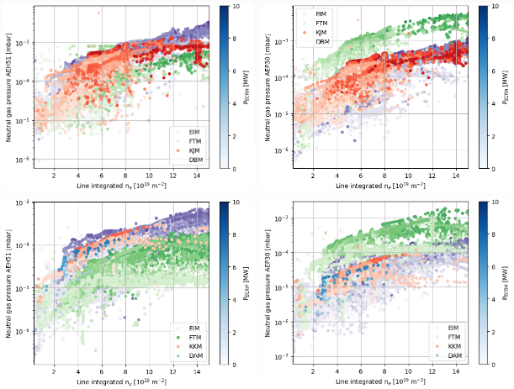
Comparison OP2.2/OP2.3
AEH51 OP2.2
AEP30 OP2.2
AEH51 OP2.3
AEP30 OP2.3

Slide 22
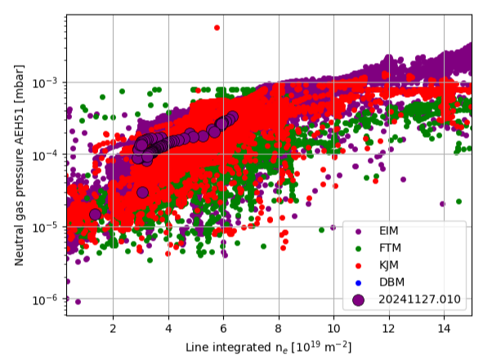
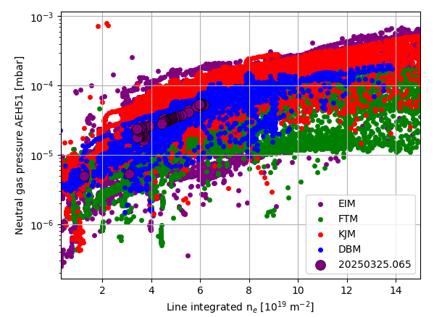
Comparison AEH51 OP2.2/OP2.3 - pressure
AEH51 OP2.2
AEH51 OP2.3

Slide 23
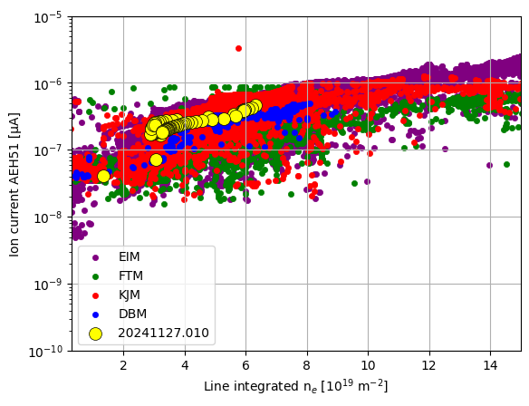

Comparison AEH51 OP2.2/OP2.3 – ion current
AEH51 OP2.2
AEH51 OP2.3

Slide 24


Comparison AEP30 OP2.2/OP2.3 - pressure
AEP30 OP2.2
AEP30 OP2.3

Slide 25


Comparison AEP30 OP2.2/OP2.3 – ion current
AEP30 OP2.2
AEP30 OP2.3

Slide 26


Calibration programs (18 pressure levels)
Die untenstehende Liste enthält die Programme und die dazugehörige Verzögerung zwischen erstem Gaspuls (typischerweise so klein, dass das Ventil nicht öffnet). Vorsicht auch mit 20240926.23 - dieses Programm sollten wir komplett rauslassen, es hat einen ganz anderen Aufbau.
[('20240910.29', 25), PP:267560 (EIM000+2520, He, BG034)
('20240910.30', 25), PP:405337 (EIM000+2520, H2, BG013)
13.09.2024 Boronization I
('20240926.21', 60), PP:608266 (He, BG034) (EIM000+2520)
('20240926.22', 60), PP:608269 (H2, BG013) (EIM000+2520)
('20240926.23', 25), PP:593818 (60%He/40%H2), (EIM000+2520)
18 equal inject., each 770 ms, BG034
18.10.2024 Boronization II
22.11.2024 Boronization III
14.02.2025 Boronization IV
('20250218.40', 25), PP:405337 (EIM000-1800, H2, BG013)
('20250220.25', 25), PP:405337 (EIM000-2520, H2, BG013)
('20250220.24', 25), PP:267560 (EIM000-2520, He, BG034)
11.04.2025 Boronization V
('20250604.1', 25), PP:405337 (FMM001+2520, CC=0 (NPC=13.47 kA, PC=-3.79 kA))
('20250605.43', 25)] PP:405337 (EJM+2536=EJM008+2520, CC=0) (NPC=13.19, PC=-1.04 kA)
20250220.24: PP:267560 (Helium, BG034)
20240910.30: PP:405337 (H2, BG013)
20250220.25: PP:405337 (H2, BG013)

Slide 27



Calibration programs (18 pressure levels)

Slide 28

Comparison NGM ion currents in OP2.2 and OP2.3

Slide 29

Comparison NGM ion currents in OP2.2 and OP2.3
AEI50
AEH51
AEP51
AEP30
OP2.2/2.3 comparison: at 6e19 almost the same I_{ion}
AEH51, AEI50, AEP51, AEP30

Slide 30


Comparison AEH50: H2 2.5T, EIM000+2520 and EIM000-2520
20240910.30 (before B) - blue
20240926.22 (after B) - orange
20250220.25 (after B, reversed field) - green
same pressure for blue/red/orange
low pressure for green
same I_{ion} for orange=blue & red=green
why is I_{ion} for red < I_{ion} for blue/orange
I_{ele} ok
AEH51, AEI50, AEP51, AEP30

Slide 31


Comparison AEH51: H2 2.5T, EIM000+2520 and EIM000-2520
20240910.30 (before B) - blue
20240926.22 (after B) - orange
20250220.25 (after B, reversed field) - green
same pressure for blue/red/orange
low pressure for green
same I_{ion} at higher pressure only
why is I_{ion} for green > I_{ion} for blue/orange/red
(this is different to AEH50 – reversed field?)
I_{ele} too small for red at lower pressures
AEH51, AEI50, AEP51, AEP30

Slide 32


Comparison AEI50: H2 2.5T, EIM000+2520 and EIM000-2520
20240910.30 (before B) - blue
20240926.22 (after B) - orange
20250220.25 (after B, reversed field) - green
same pressure for blue/red/orange
low pressure for green
same I_{ion} at higher pressure only
why is I_{ion} for green > I_{ion} for blue/orange/red
(this is different to AEH50 – reversed field?
data for AEI51?)
I_{ele} ok
AEH51, AEI50, AEP51, AEP30

Slide 33


Comparison AEP51: H2 2.5T, EIM000+2520 and EIM000-2520
20240910.30 (before B) - blue
20240926.22 (after B) - orange
20250220.25 (after B, reversed field) - green
same pressure for blue/red/orange
low pressure for green
same I_{ion} at higher pressure only
why is I_{ion} for green > I_{ion} for blue/orange/red
(this is different to AEH50 – reversed field?
data for AEP50?)
I_{ele} too low at 50 μA for red
AEH51, AEI50, AEP51, AEP30

Slide 34


Comparison AEP30: H2 2.5T, EIM000+2520 and EIM000-2520
20240910.30 (before B) - blue
20240926.22 (after B) - orange
20250220.25 (after B, reversed field) - green
same pressure for blue/red/orange
low pressure for green
same I_{ion} at higher pressure
why is I_{ion} for green > I_{ion} for blue/orange/red
(this is different to AEH50 – reversed field?
data for AEP31?)
I_{ele} ok
AEH51, AEI50, AEP51, AEP30

Slide 35


Comparison AEL10: H2 2.5T, EIM000+2520 and EIM000-2520
20240910.30 (before B) - blue
20240926.22 (after B) - orange
20250220.25 (after B, reversed field) - green
same pressure for blue/red/orange
low pressure for green
same I_{ion} at higher pressure only
why is I_{ion} for green > I_{ion} for blue/orange/red
I_{ele} ok
AEH51, AEI50, AEP51, AEP30

Slide 36


Comparison AEH50: H2 1.8T, EIM000-1800
20250218.40 (after B)
AEH51, AEI50, AEP51, AEP30

Slide 37


Comparison AEH50: H2, EIM000+2520 and EIM000-1800
20240910.30 (before B) - blue
20240926.22 (after B) - orange
20250218.40 (after B, reversed field) - green
same pressure for blue/orange
low pressure for green
same I_{ion} for orange=blue
significant smaller I_{ion} values for green
Source: PhD Thesis B. Jagielski
AEH51, AEI50, AEP51, AEP30

Slide 38

Comparison AEH51: H2, EIM000+2520 and EIM000-1800
20240910.30 (before B) - blue
20240926.22 (after B) - orange
20250218.40 (after B, reversed field) - green
same pressure for blue/orange
low pressure for green
same I_{ion} at higher pressure only
similar I_{ion} values for green
at higher pressure
AEH51, AEI50, AEP51, AEP30

Slide 39

Comparison AEI50: H2, EIM000+2520 and EIM000-1800
20240910.30 (before B) - blue
20240926.22 (after B) - orange
20250218.40 (after B, reversed field) - green
same pressure for blue/orange
low pressure for green
same I_{ion} at higher pressure only
similar I_{ion} values for green
at higher pressure
AEH51, AEI50, AEP51, AEP30

Slide 40

Comparison AEP51: H2, EIM000+2520 and EIM000-1800
20240910.30 (before B) - blue
20240926.22 (after B) - orange
20250218.40 (after B, reversed field) - green
same pressure for blue/orange
low pressure for green
same I_{ion} at higher pressure only
similar I_{ion} values for green
at higher pressure
AEH51, AEI50, AEP51, AEP30

Slide 41

Comparison AEP30: H2, EIM000+2520 and EIM000-1800
20240910.30 (before B) - blue
20240926.22 (after B) - orange
20250218.40 (after B, reversed field) - green
same pressure for blue/orange
low pressure for green
same I_{ion} at higher pressure
similar I_{ion} values for green
AEH51, AEI50, AEP51, AEP30

Slide 42

Comparison AEL10: H2, EIM000+2520 and EIM000-1800
20240910.30 (before B) - blue
20240926.22 (after B) - orange
20250218.40 (after B, reversed field) - green
same pressure for blue/orange
low pressure for green
same I_{ion} at higher pressure only
similar I_{ion} values for green
at higher pressure
AEH51, AEI50, AEP51, AEP30

Slide 43



Comparison OP2.2 and OP2.3: best performing NGM
AEI50, He
AEP30, He
AEH50, H2
hydrogen, AEH50
helium, AEP30, AEI50

Slide 44
Comparison NGM ion currents in OP2.2 and OP2.3

Slide 45
Comparison

